Slide 1
Computer Organization & Design The Hardware/Software Interface
计算机组成与设计
Chapter 3
Arithmetic for Computer

Slide 2
Contents of Chapter 3
3.1 Introduction
3.2 Signed and Unsigned Numbers-Possible Representations
3.3 Arithmetic--Addition & subtraction and ALU
3.4 Multiplication
3.5 Division
3.6 Floating point numbers

Slide 3
3.1 Introduction
Computer words are composed of bits;
thus words can be represented as binary numbers
there are 32bits/word or 64bits/word in RISC-V
Contains four bytes for 32bits word
Simplified to contain only in course:
memory-reference instructions: lw, sw
arithmetic-logical instructions: add, sub, and, or, xor, slt…
control flow instructions: beq, bne, jal
Generic Implementation:
use the program counter (PC) to supply instruction address
get the instruction from memory
read registers
use the instruction to decide exactly what to do
All instructions use the ALU after reading the registers Why? memory-reference? arithmetic? control flow?

Slide 4
Numbers
Bits are just bits (no inherent meaning)— conventions define relationship between bits and numbers
Binary numbers (base 2) 0000 0001 0010 0011 0100 0101 0110 0111 1000 1001... decimal: 0 1 2 3...2^{n}-1
Of course it gets more complicated: numbers are finite (overflow) fractions and real numbers negative numbers
How do we represent numbers? i.e., which bit patterns will represent which numbers?

Slide 5
Do you Know?
What is this about following Digital?
00110011110111100000000100000000₂
Don’t know! (Do not know, is the right answer !)
Ah, Why?
Because different occasions have different meaning
The possible meaning is
IP Address
Machine instructions
Values of Binary number :
Integer
Fixed Point Number
Floating Point Number

Slide 6
For binary integer
The following 4-bit binary integer What does it mean?
1001₂
Don’t know!
Ah, still do not know for?
Integer representation of different methods have different meaning
Unsigned 1001₂=9₁₀
Signed 1001₂=-1₁₀ or -7₁₀ ?
Do not know, is the right answer !

Slide 7
3.2 Signed and Unsigned Numbers Possible Representations
Sign Magnitude: One's Complement Two's Complement 000 = +0 000 = +0 000 = +0 001 = +1 001 = +1 001 = +1 010 = +2 010 = +2 010 = +2 011 = +3 011 = +3 011 = +3 100 = -0 100 = -3 100 = -4 101 = -1 101 = -2 101 = -3 110 = -2 110 = -1 110 = -2 111 = -3 111 = -0 111 = -1
Which one is best? Why?
Issues: number of zeros, ease of operations

Slide 8
Numbers and their representation
Number systems
Radix based systems are dominating
decimal, octal, binary,…
A: value of the digit, k: radix, n: digits left of radix point, m: digits right of radix point
Alternatives, e.g. Roman numbers (or Letter)
Decimal (k=10) → used by humans
Binary (k=2) → used by computers
0≤A≤K
(N)_{k}＝(A_{n－1}A _{n－2}A _{n－3}…A ₁A ₀ • A₋₁A _{-２}A…A _{–m+1}A _{– m})_{k}
MSD
LSD
Notes:
Radix =基数
罗马数字共有7个，即Ⅰ(1)，Ⅴ(5)，Ⅹ(10)，Ⅼ(50)，Ⅽ(100)，Ⅾ(500)，Ⅿ(1000)。需要注意的是罗马数字中没有“0”。

Slide 9
Numbers and their representation
Representation
ASCII - text characters
Easy read and write of numbers
Complex arithmetic (character wise)
Binary number
Natural form for computers
Requires formatting routines for I/O

Slide 10
Number types
Integer numbers, unsigned
Address calculations
Numbers that can only be positive
Signed numbers
Positive
Negative
Floating point numbers
numeric calculations
Different grades of precision
Singe precision (IEEE)
Double precision (IEEE)
Quadruple precision

Slide 11
Number formats
Sign and magnitude
2's complement
1's complement
similar to 2's complement, + 0 & - 0
Biased notation
1000 0000 = minimal negative value(-2⁷)
0111 1111 = maximal positive value (2⁷-1)
Representation
Binary
Decimal
Hexadecimal
Notes:
移码，加上2^n

Slide 12
Signed number representation
First idea:
Positive and negative numbers
Take one bit (e.g. 31) as the sign bit
Problem
0 0000000 = 0 positive zero!
1 0000000 = 0 negative zero!
Each comparison to 0 requires two steps
1's complement
2's complement

Slide 13
Two's Complement Operations
Negating a two's complement number:
invert all bits & add 1 with end
remember: “negate” and “invert” are quite different!
Defining : Assume:x＝±0.x₋₁x_{-２}x_{-３}…x_{-m} OR x＝±x_{n-1}x_{-n-２}x_{-n-３}x_{-n-4}…x₋₀
Converting n bit numbers into numbers with more than n bits:
MIPS 16 bit immediate gets converted to 32 bits for arithmetic
copy the most significant bit (the sign bit) into the other bits 0010 -> 0000 0010 1010 -> 1111 1010
Ｘ 0≤X<1
２＋Ｘ＝2－|Ｘ| -1≤X<0
fraction
[X]_{C}＝
Ｘ 0≤X<2^{n}
2^{n+1}＋Ｘ＝2^{n+1}－|Ｘ| -2^{n}≤X<0
integer
Notes:
Negative: 负数

Slide 14
2's complement for n=3
The absolute value of the sum of two=2^{n}
Only one representation for 0
One more negative number than positive number
2^{n+1}＋Ｘ＝2^{n+1}-|Ｘ|
＝ 2⁴ －8
＝(10000-1000)₂
＝ 01000
0 100 =+4
1 100 =-4

Slide 15
More common: use of 2's complement ---- negatives have one additional number
(0000 0000 0000 0000 0000 0000 0000 0000)₂ =(0)₁₀
(0000 0000 0000 0000 0000 0000 0000 0001)₂ =(1)₁₀
………… ………
(0111 1111 1111 1111 1111 1111 1111 1101)₂ =( 2，147，483，645)₁₀
(0111 1111 1111 1111 1111 1111 1111 1110)₂ =( 2，147，483，646)₁₀
(0111 1111 1111 1111 1111 1111 1111 1111)₂ =( 2，147，483，647)₁₀
(1000 0000 0000 0000 0000 0000 0000 0000)₂ =(-2，147，483，648)₁₀
(1000 0000 0000 0000 0000 0000 0000 0001)₂ =(-2，147，483，647)₁₀
(1000 0000 0000 0000 0000 0000 0000 0010)₂ =(-2，147，483，646)₁₀
………… ………
(1111 1111 1111 1111 1111 1111 1111 1101)₂ =(-3)₁₀
(1111 1111 1111 1111 1111 1111 1111 1110)₂ =(-2)₁₀
(1111 1111 1111 1111 1111 1111 1111 1111)₂ =(-1)₁₀
Notes:
-1就是全1，最大的负数是100000.。。000

Slide 16
Two's Biased notation
Negating Biased notation number:
invert all bits and add 1 with end
Defining : Assume: x＝±x_{-(n-1)}x_{-(n-２)}x_{-(n-３)}x_{-(n-4)}…x₋₀
X=＋1011 [X]_{b}=11011 sign bit “1” Positive X=－1011 [X]_{b}=00101 sign bit “0” Negative
2's Biased notation VS 2's complement
Only reverse sign bit
e.g.
X=＋1011 [X]c=01011 [X]b=11011
X=－1011 [X]c=10101 [X]b=00101
[X]_{b}＝ 2^{n}＋Ｘ -2^{n}≤X ≤ 2^{n}
[0]b ＝100000…(2^{n})
biase
IEEE 754: [X]_{b}＝ 2^{n}-1＋Ｘ

Slide 17
sign extension (lbu vs. lb)
Expansion
e.g. 8 bit numbers to 64/32 bit numbers
Required for operations with registers(32/64 bits) and immediate operands (8 bits)
Sign extension
Take the lower 8 bits as they are
Copy the highest bit to the remaining 24/56 bits
0000 0010 → 2
0000 0000 0000 0000 0000 0000 0000 0010
1111 1110 → -2
1111 1111 1111 1111 1111 1111 1111 1110

Slide 18
3.3 Arithmetic
Addition and Subtraction
Logical operations
Constructing a simple ALU
Multiplication
Division
Floating point arithmetic
Adding all parts to get an ALU

Slide 19
Addition & subtraction
Adding bit by bit, carries → next digit
0000 0111 7₁₀
+ 0000 0110 6₁₀
0000 1101 13₁₀
Subtraction
Directly
Addition of 2's complement
0000 0111 7₁₀
- 0000 0110 6₁₀
0000 0001 1₁₀
0000 0111 7₁₀
+ 1111 1010 -6₁₀
0000 0001 1₁₀

Slide 20
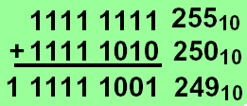
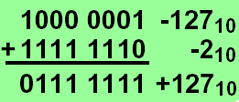
Overflow
The sum of two numbers can exceed any representation
The difference of two numbers can exceed any representation
2's complement:
Numbers change
sign and size
Notes:
同号数相加或者异号数相减， 可能发生溢出。

Slide 21
Overflow conditions
General overflow conditions
Operation | Operand A | Operand B | Result overflow
A+B | ≧0 | ≧0 | <0 (01)
A+B | <0 | <0 | ≧0 (10)
A-B | ≧0 | <0 | <0 (01)
A-B | <0 | ≧0 | ≧0 (10)
Double sign-bits

Slide 22
Reaction of Overflow
An exception (interrupt) occurs
Control jumps to predefined address for exception
Interrupted address is saved for possible resumption
Signaling to application (Ada, Fortran)
Ignore, don't always want to detect overflow note: sltu, sltiu for unsigned comparisons

Slide 23
Overflow process
Hardware detection in the ALU
Generation of an exception (interrupt)
Save the instruction address (not PC) in special register SEPC
Jump to specific routine in OS
Correct & return to program
Return to program with error code
Abort program

Slide 24
Arithmetic for Multimedia
Graphics and media processing operates on vectors of 8-bit and 16-bit data
Use 64-bit adder, with partitioned carry chain
Operate on 8×8-bit, 4×16-bit, or 2×32-bit vectors
SIMD (single-instruction, multiple-data)
Saturating operations
On overflow, result is largest representable value
c.f. 2s-complement modulo arithmetic
E.g., clipping in audio, saturation in video

Slide 25
Logical operations
Logical shift operations
right (srl)
left (sll)
The machine instruction for the instruction slli x11, x9, 3
Example: slli x11, x9, 3
x9: 0000 0000 0000 0000 1100 1000 0000 1111
x11: 0000 0000 0000 0110 0100 0000 0111 1000
Filled with '0'
Op | Rs | Rt | Rd | Shamt | Adr/funct
0 | 0 | 16 | 10 | 3 | 0

Slide 26
Logical operations skip
AND→bit-wise AND between registers
and register1, register2, register3
OR →bit-wise OR between registers
or register1, register2, register3
Example:
and x3, x10, x16
or x4, x10, x16
x16: 0000 0000 0000 0000 1100 1000 0000 1111
x10: 0000 0000 0000 0110 0100 0000 0111 1000
x3: 0000 0000 0000 0000 0100 0000 0000 1000
x4: 0000 0000 0000 0110 1100 1000 0111 1111

Slide 27
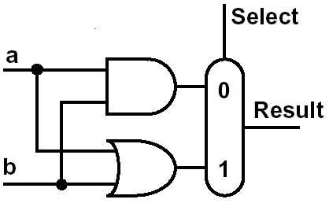
Constructing an ALU
Two methods constitute the ALU
extended the adder
Parallel redundant select
Step by step:
build a single bit ALU
and expand it to the desired width
First function:
logic AND and OR

Slide 28
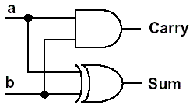
A half adder
Sum = b + a
Carry = a b

Slide 29
A full adder
Accepts a carry in
Sum = A + B + Carry_{In}
Carry_{Out} = B Carry_{In} + A Carry_{In} + A B
Inputs |  |  | Outputs |  | Comments
A | B | Carry_{In} | Carry_{Out} | Sum
0 | 0 | 0 | 0 | 0 | 0+0+0=00
0 | 0 | 1 | 0 | 1 | 0+0+1=01
0 | 1 | 0 | 0 | 1 | 0+1+0=01
0 | 1 | 1 | 1 | 0 | 0+1+1=10
1 | 0 | 0 | 0 | 1 | 1+0+0=01
1 | 0 | 1 | 1 | 0 | 1+0+1=10
1 | 1 | 0 | 1 | 0 | 1+1+0=10
1 | 1 | 1 | 1 | 1 | 1+1+1=11

Slide 30
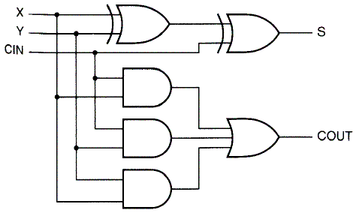
Full adder Logic circuit
Full adder in 2-level design
+

Slide 31
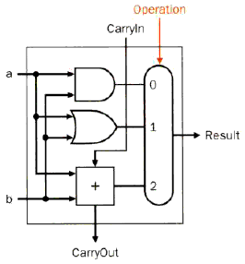
1 bit ALU
ALU
AND
OR
ADD
Cell Cascade Element

Slide 32
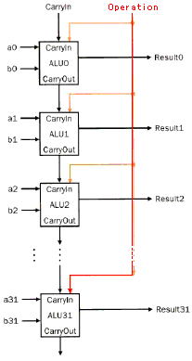
Basic 32 bit ALU
Inputs parallel
Carry is cascaded
Ripple carry adder
行波进位加法器
Slow, but simple
1st Carry In = 0

Slide 33
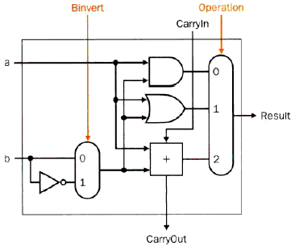
Extended 1 bit ALU-- Subtraction
Subtraction
a - b
Inverting b
1st CarryIn= 1

Slide 34
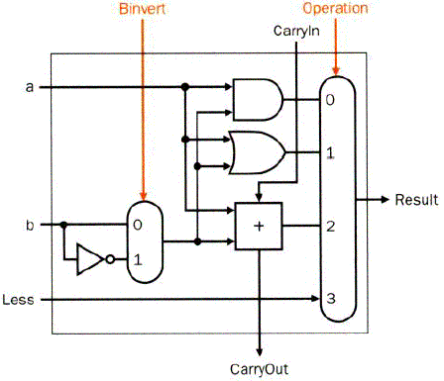
Extended 1 bit ALU-- comparison
Functions
AND
OR
Add
Subtract
Missing: comparison
slt rd,rs,rt
If rs < rt, rd=1, else rd=0
All bits = 0 except the least significant
Subtraction (rs - rt), if the result is negative→ rs < rt
Use of sign bit as indicator

Slide 35
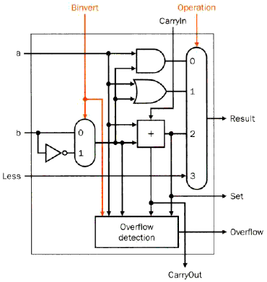
Most significant bit
Set for comparison
Overflow detect
Cell Cascade Element
Operation | Operand A | Operand B | Result overflow
A+B | ≧0 | ≧0 | <0 (01)
A+B | <0 | <0 | ≧0 (10)
A-B | ≧0 | <0 | <0 (01)
A-B | <0 | ≧0 | ≧0 (10)
Last
significant bit
Most
significant bit

Slide 36
Complete ALU
Input
A、B
Control lines
Binvert
Operation
Carry in
Output
Result
Overflow
Slow, but simple
Inputs parallel
Carry is cascaded
Ripple carry adder
Iterative Circuit

Slide 37
Complete ALU —with Zero detector
Add a Zero detector

Slide 38
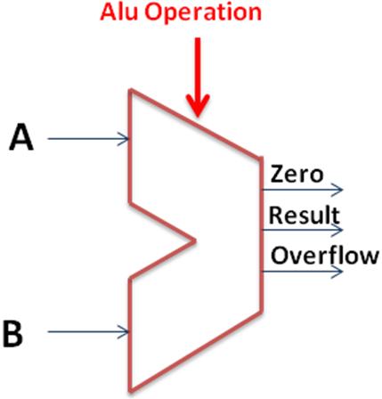
ALU symbol & Control
Symbol of the ALU
Control：Function table
ALU Control Lines | Function
000 | And
001 | Or
010 | Add
110 | Sub
111 | Set on less than
100 | nor
101 | srl
011 | xor

Slide 39
ALU Hardware Code
module alu(A, B, ALU_operation, res, zero, overflow );
input [31:0] A, B;
input [2:0] ALU_operation;
output [31:0] res;
output zero, overflow ;
wire [31:0] res_and,res_or,res_add,res_sub,res_nor,res_slt;
reg [31:0] res;
parameter one = 32'h00000001, zero_0 = 32'h00000000;
assign res_and = A&B;
assign res_or = A|B;
assign res_add = A+B;
assign res_sub = A-B;
assign res_slt =(A < B) ? one : zero_0;
always @ (A or B or ALU_operation)
case (ALU_operation)
3'b000: res=res_and;
3'b001: res=res_or;
3'b010: res=res_add;
3'b110: res=res_sub;
3'b100: res=~(A | B);
3'b111: res=res_slt;
default: res=32'hx;
endcase
assign zero = (res==0)? 1: 0;
endmodule
How do you write with overflow code ?
What is the difference The codes in the Synthesize?
always @ (A or B or ALU_operation)
case (ALU_operation)
3'b000: res=A&B;
3'b001: res=A|B;
3'b010: res=A+B;
3'b110: res=A-B;
3'b100: res=~(A | B);
3'b111: res=(A < B) ? one : zero_0;
default: res=32'hx;
endcase

Slide 40

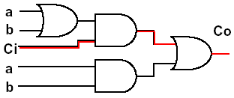
Speed considerations
Previously used: ripple carry adder
Delay for the sum: two units
Delay for the carry:
two - three units
A_{i}
B_{i}
G_{i}
P_{i}
C_{i}
C_{i+1}
S_{i}

Slide 41
Speed considerations
Delay of one adder
2 time units
Total delay for stages: 2n unit delays
Not appropriate for high speed application
A3
A2
A1
A0
B3
B2
B1
B0
C3
C2
C1
C0
C4
S3
S2
S1
S0

Slide 42
Fast adders
All functions can be represented in 2-level logic.
But:
The number of inputs of the gates would drastically rise
Target:
Optimum between speed and size

Slide 43
Fast adders
Carry look-ahead adder
Calculating the carries before the sum is ready
Carry skip adder
Accelerating the carry calculation by skipping some blocks
Carry select adder
Calculate two results and use the correct one
...

Slide 44
Carry Lookahead Adder (CLA)
Given Stage i from a Full Adder, we know that there will be a carry generated when A_{i} = B_{i} = "1", whether or not there is a carry-in
Alternately, there will be a carry propagated if the “half-sum” is "1" and a carry-in, C_{i} occurs, then C_{i+1}=1
These two signal conditions are called
generate, denoted as G_{i}
propagate, denoted as P_{i}
A_{i}
B_{i}
G_{i}
P_{i}
C_{i}
C_{i+1}
S_{i}
Notes:
gi = ai * bi
pi = ai + bi

Slide 45
Addition formula in CLA
In the ripple carry adder:
G_{i}, P_{i}, and S_{i} are local to each cell of the adder
C_{i} is also local each cell
In the carry lookahead adder, in order to reduce the length of the carry chain, Ci is changed to a more global function spanning multiple cells
Defining the equations for the Full Adder in term of the P_{i} and G_{i}:
P
=
A
⊕
B
G
=
A
B
i
i
i
i
i
i
S
=
P
⊕
C
C
=
G
+
P
C
i
i
i
i
+
1
i
i
i

Slide 46
Carry Lookahead Development
C_{i+1} can be removed from the cells and used to derive a set of carry equations spanning multiple cells.
Beginning at the cell 0 with carry in C₀:
C₁ = G₀ + P₀ C₀
C₂ = G₁ + P₁ C₁ = G₁ + P₁(G₀ + P₀ C₀)
= G₁ + P₁G₀ + P₁P₀ C₀
C₃ = G₂ + P₂ C₂ = G₂ + P₂(G₁ + P₁G₀ + P₁P₀ C₀)
= G₂ + P₂G₁ + P₂P₁G₀ + P₂P₁P₀ C₀
C₄ = G₃ + P₃ C₃ = G₃ + P₃G₂ + P₃P₂G₁
+ P₃P₂P₁G₀ + P₃P₂P₁P₀ C₀

Slide 47
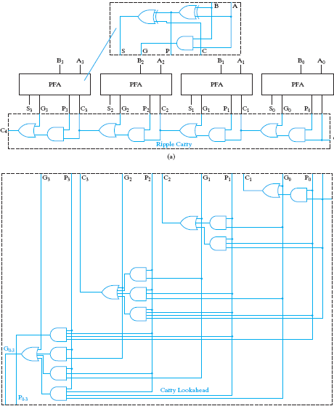
Carry Lookahead Adder
partial full adder
G
0
−
3
=
G
3
+
P
3
G
2
+
P
3
P
2
G
1
+
P
3
P
2
P
1
P
0
G
0
P
0
−
3
=
P
3
P
2
P
1
P
0

Slide 48
Group Carry Lookahead Logic
Last slide show shows the implementation of these equations for four bits. This could be extended to more than four bits; in practice, due to limited gate fan-in, such extension is not feasible.
Instead, the concept is extended another level by considering group generate (G₀₋₃) and group propagate (P₀₋₃) functions:
Using these two equations:
Thus, it is possible to have four 4-bit adders use one of the same carry lookahead circuit to speed up 16-bit addition
G
0
−
3
=
G
3
+
P
3
G
2
+
P
3
P
2
G
1
+
P
3
P
2
P
1
P
0
G
0
P
0
−
3
=
P
3
P
2
P
1
P
0
C
4
=
G
0
−
3
+
P
0
−
3
C
0

Slide 49
Extended Example: 16 carry lookahead adder
C₄ = G₃ + P₃G₂ + P₃P₂G₁ + P₃P₂P₁G₀ + P₃P₂P₁P₀C₀ = G_{0~3}+ P_{0~3}C₀
C₈ = G₇ + P₇G₆ + P₇P₆G₅ + P₇P₆P₅G₄ + P₇P₆P₅P₄C₄ = G_{4~7}+ P_{4~7}C₄
C₁₂ =G₁₁+P₁₁G₁₀+P₁₁P₁₀G₉+P₁₁P₁₀P₉G₈+P₁₁P₁₀P₉P₈C₈ = G_{8~11}+ P_{8~11}C₈
C₁₆=G₁₅+P₁₅G₁₄+P₁₅P₁₄G₁₃+P₁₅P₁₄P₁₃G₁₂+P₁₅P₁₄P₁₃P₁₂C₁₂ = G_{12~15}+ P_{12~15}C₁₂
= G_{12~15}+ P_{12~15}(G_{8~11}+ P_{8~11}(G_{4~7}+ P_{4~7}(G_{0~3}+ P_{0~3}C₀)))
G_{0~3} = G₃ + P₃G₂ + P₃P₂ G₁ +P₃P₂P₁G₀
G_{4~7} = G₇ + P₇G₆ + P₇P₆G₅ + P₇P₆P₅G₄
G_{8~11} = G₁₁+P₁₁G₁₀+P₁₁P₁0G₉+P₁₁P₁₀P₉G₈
G_{12~15}= G₁₅+P₁₅G₁₄+P₁₅P₁₄G₁₃+P₁₅P₁₄P₁₃G₁₂
P_{0~3} = P₃ P₂ P₁ P₀
P_{4~7} = P₇ P₆ P₅ P₄
P_{8~11} = P₁₁ P₁₀ P₉ P₈
P_{12~15}= P₁₅ P₁₄ P₁₃ P₁₂
C₄ = G₃ + P₃G₂ + P₃P₂G₁ + P₃P₂P₁G₀ + P₃P₂P₁P₀ C₀
CLA
CLA
CLA
CLA
CLA

Slide 50
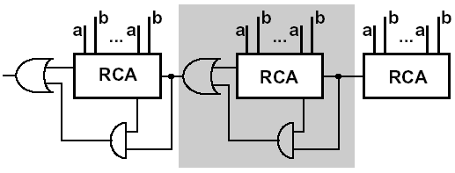
Carry skip adder
Accelerating the carry by skipping the interior blocks
Optimal speed with no-equal distribution of block length

Slide 51
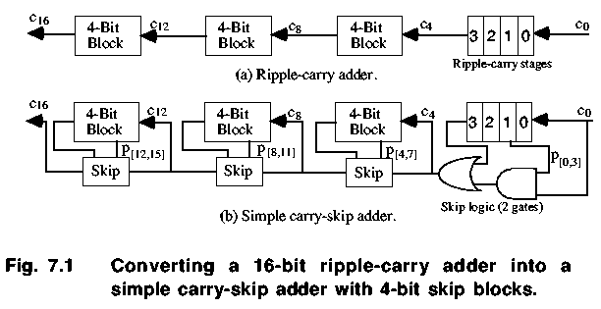
Carry skip adder

Slide 52
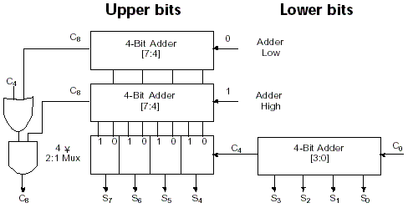
Carry select adder (CSA)

Slide 53
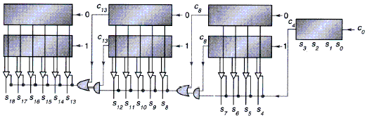
Carry select adder
Carry selection by nibbles

Slide 54
3.4 Multiplication
Binary multiplication
Multiplicand × Multiplier
1000 × 1001
Look at current bit position
If multiplier is 1
then add multiplicand
Else add 0
shift multiplicand left by 1 bit
 |  |  |  | 1 | 0 | 0 | 0
 |  |  | × | 1 | 0 | 0 | 1
 |  |  |  | 1 | 0 | 0 | 0
 |  |  | 0 | 0 | 0 | 0
 |  | 0 | 0 | 0 | 0
+ | 1 | 0 | 0 | 0
 | 1 | 0 | 0 | 1 | 0 | 0 | 0
Notes:
Multiplicand=被乘数 Multiplier=乘数

Slide 55
Multiplier V1– Logic Diagram
64 bits: multiplier
128 bits: multiplicand, product, ALU
0010*0011
M
u
l
t
i
p
l
i
c
a
n
d
0000 0010
S
h
i
f
t
l
e
f
t
128
b
i
t
s
0011
M
u
l
t
i
p
l
i
e
r
128
-
b
i
t
A
L
U
S
h
i
f
t
r
i
g
h
t
64 bits
P
r
o
d
u
c
t
C
o
n
t
r
o
l
t
e
s
t
0000 0110
W
r
i
t
e
128
b
i
t
s

Slide 56
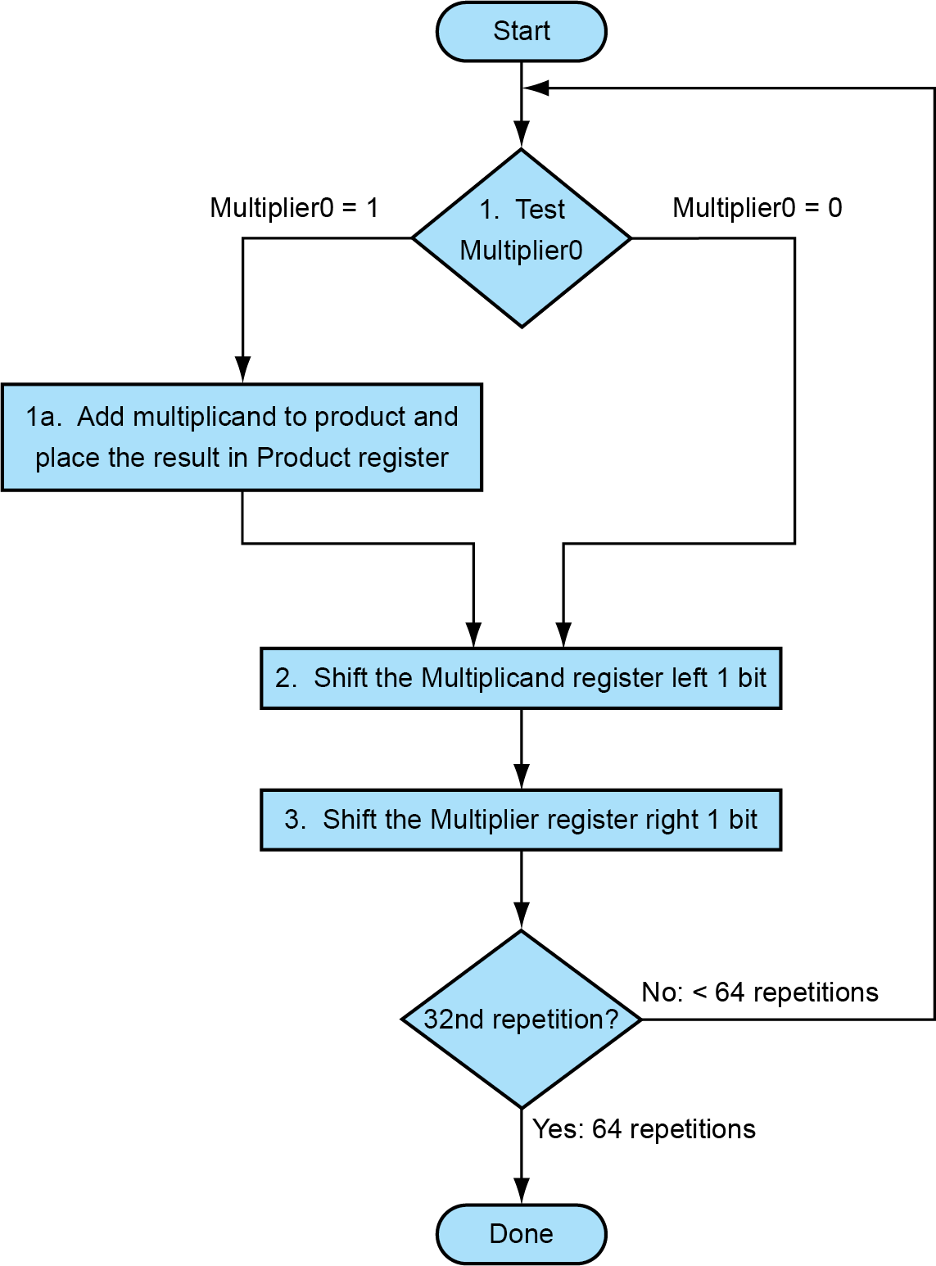
Multiplier V1--Algorithmic rule
Requires 64 iterations
Addition
Shift
Comparison
Almost 200 cycles
Very big, Too slow!
64th repetition?

Slide 57
Multiplier V2
Real addition is performed only with 64 bits
Least significant bits of the product don't change
New idea:
Don’t shift the multiplicand
Instead, shift the product
Shift the multiplier
ALU reduced to 64 bits!
 |  |  |  | 1 | 0 | 0 | 0
 |  |  | × | 1 | 0 | 0 | 1
 |  |  |  | 1 | 0 | 0 | 0
 |  |  | 0 | 0 | 0 | 0
 |  | 0 | 0 | 0 | 0
+ | 1 | 0 | 0 | 0
 | 1 | 0 | 0 | 1 | 0 | 0 | 0

Slide 58
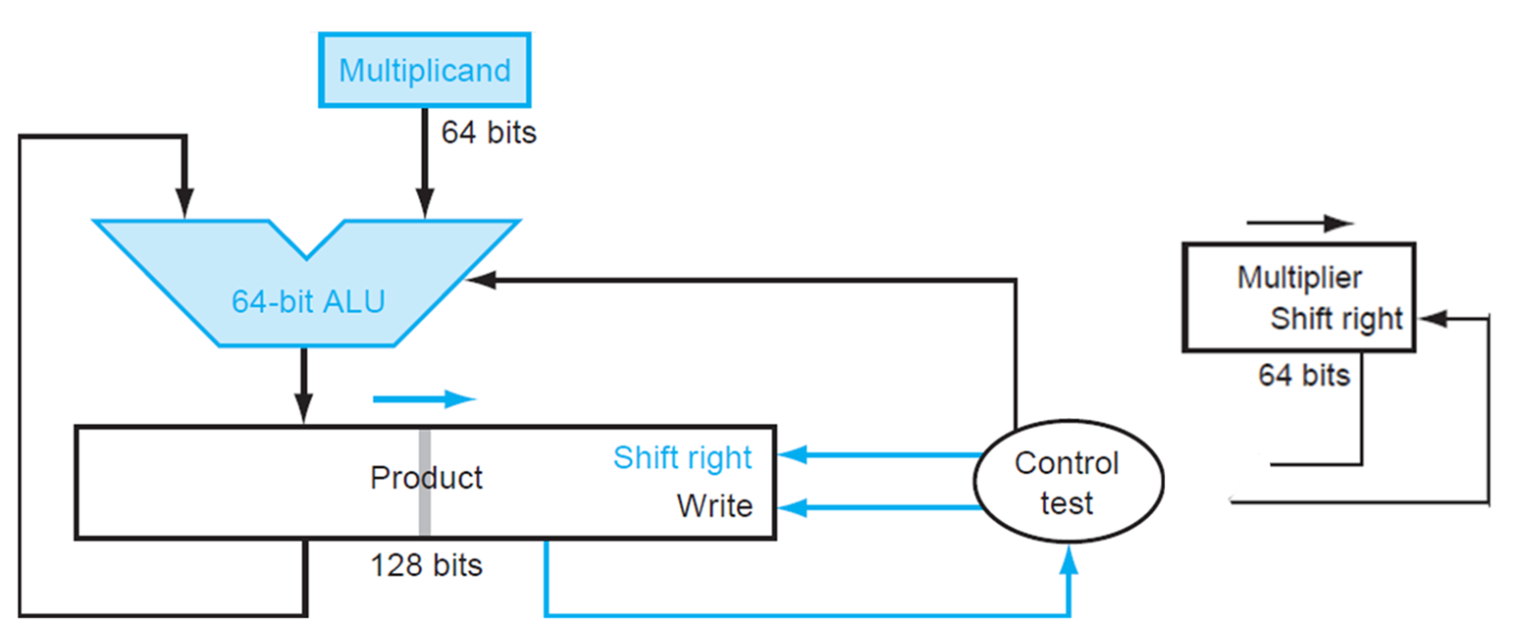
Multiplier V2-- Logic Diagram
Diagram of the V2 multiplier
Only left half of product register is changed

Slide 59
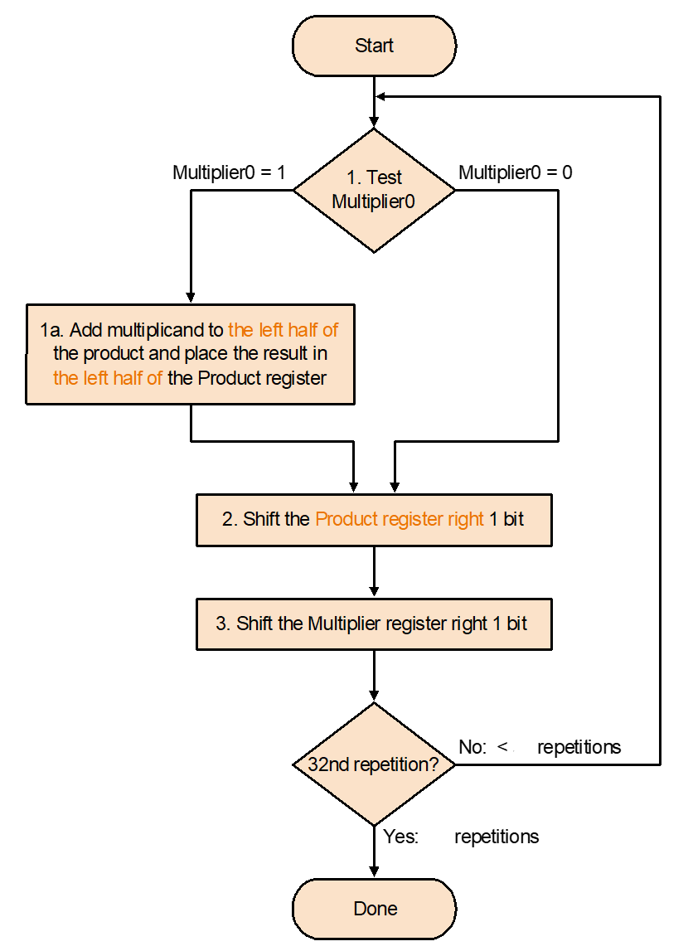
Multiplier V2----Algorithmic rule
Addition performed
only on left half of
product register
Shift of product register
64
64th repetiion?
64

Slide 60
Revised 4-bit example with V2
Multiplicand x multiplier: 0001 x 0111
Multiplicand: | 0001
Multiplier:× | 0111
 | 0000 | 0000 |  | #Initial value for the product
1 | 0001 | 0000 |  | #After adding 0001, Multiplier=1
 | 0000 | 1000 | 0 | #After shifting right the product one bit
 | 0001
2 | 0001 | 1000 |  | #After adding 0001, Multiplier=1
 | 0000 | 1100 | 0 | #After shifting right the product one bit
 | 0001 |  |  | #After adding 0001, Multiplier=1
3 | 0001 | 1100
 | 0000 | 1110 | 0 | #After shifting right the product one bit
 | 0000
4 | 0000 | 1110 |  | #After adding 0001, Multiplier=0
 | 0000 | 0111 | 0 | #After shifting right the product one bit
Shift out

Slide 61
Multiplier V 3
Further optimization
At the initial state the product register contains only '0'
The lower 64 bits are simply shifted out
Idea: use these lower 64 bits for the multiplier
multiplier
0 | 0 | 0 | 1 | 0 | 0 | 0 | 0
0 | 0 | 0 | 1 | 1 | 0 | 0 | 0 | 0
0 | 0 | 0 | 1 | 1 | 1 | 0 | 0 | 0 | 0
0 | 0 | 0 | 0 | 1 | 1 | 1 | 0 | 0 | 0 | 0
0 | 0 | 0 | 0 | 0 | 1 | 1 | 1 | 0 | 0 | 0 | 0

Slide 62
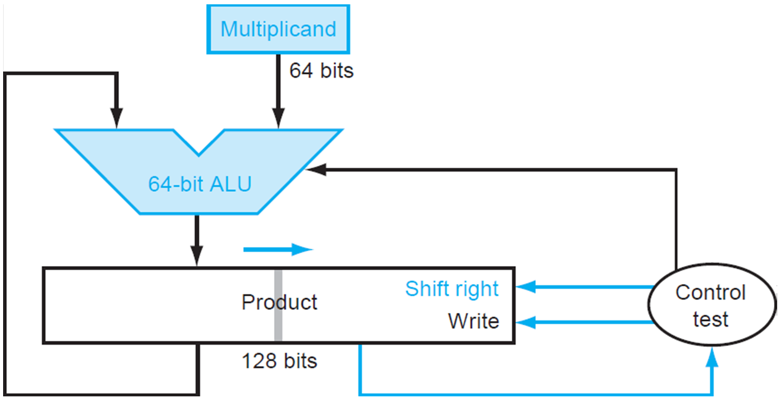
Multiplier V3 Logic Diagram
Notes:
Product实际是129位，来保存加法器的进位。

Slide 63
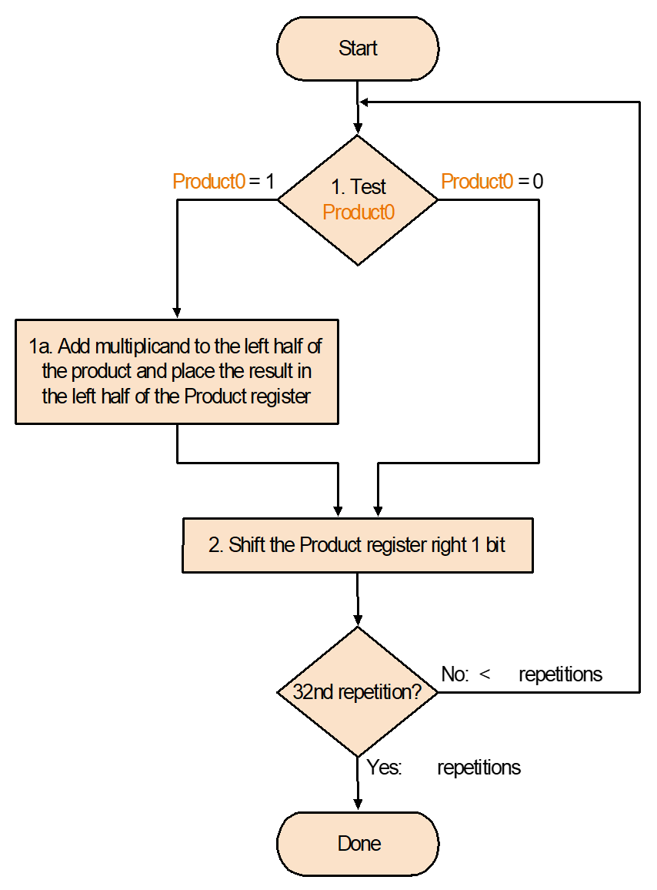
Multiplier V3--Algorithmic rule
Set product register to '0'
Load lower bits of product
register with multiplier
Test least significant bit of product register
64
64th repetiion?
64

Slide 64
Example with V3
Multiplicand x multiplier: 0001 x 0111
Multiplicand: | 0001
Multiplier:× | 0111
 | 0000 | 0111 |  | #Initial value for the product
1 | 0001 | 0111 |  | #After adding 0001, Multiplier=1
 | 0000 | 1011 | 1 | #After shifting right the product one bit
 | 0001
2 | 0001 | 1011 |  | #After adding 0001, Multiplier=1
 | 0000 | 1101 | 1 | #After shifting right the product one bit
 | 0001 |  |  | #After adding 0001, Multiplier=1
3 | 0001 | 1101
 | 0000 | 1110 | 1 | #After shifting right the product one bit
 | 0000
4 | 0000 | 1110 |  | #After adding 0001, Multiplier=0
 | 0000 | 0111 | 0 | #After shifting right the product one bit
Shift out

Slide 65
Signed multiplication
Basic approach:
Store the signs of the operands
Convert signed numbers to unsigned numbers
(most significant bit (MSB) = 0)
Perform multiplication
If sign bits of operands are equal
sign bit = 0, else
sign bit = 1
Improved method:
Booth's Algorithm
Assumption: addition and subtraction are available

Slide 66
Principle -- Decomposable multiplication
Assumes： Z=y×10111100
Z=y(10000000+111100+100-100)
=y(1×2⁷+1000000-100)
=y(1×2⁷+1×2⁶-2²)
=y(1×2⁷+1×2⁶+0×2⁵+0×2⁴+0×2³+0×2²+0×2¹+0×2⁰ -1×2² )
= y(1×2⁷+1×2⁶+0×2⁵+0×2⁴+0×2³+0×2²-1×2² +0×2¹+0×2⁰)
= y×2⁷+y×1×2⁶+0×2⁵+0×2⁴+0×2³ +0×2²-y×2² +0×2¹+0×2⁰)
add
Only shift
sub
Only shift
1 01 11 1 00

Slide 67
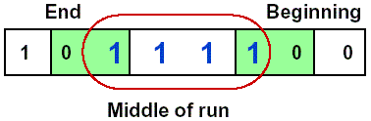
Booth's Algorithm
Idea: If you have a sequence of '1's
subtract at first '1' in multiplier
shift for the sequence of '1's
add where prior step had last '1‘
Result:
Possibly less additions and more shifts
Faster, if shifts are faster than additions

Slide 68
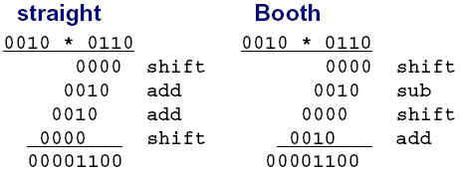
Example for Booth's Algorithm
Logic required identifying the run

Slide 69
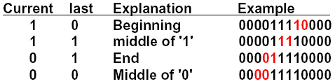
Booth's Algorithm rule
Analysis of two consecutive bits
Action
1 0 subtract multiplicand from left
1 1 no arithmetic operation-shift
0 1 add multiplicand to left half
0 0 no arithmetic operation-shift
Bit₋₁ = '0'
Arithmetic shift right:
keeps the leftmost bit constant
no change of sign bit !

Slide 70
Example with negative numbers
2 * (-3) = - 6
0010 * 1101 = 1111 1010
iteration | step | Multiplicand | product
0 | Initial Values | 0010 | 0000 1101 0
1 | 1.c:10→Prod=Prod-Mcand | 0010 | 1110 1101 0
 | 2: shift right Product | 0010 | 1111 0110 1
2 | 1.b:01→Prod=Prod+Mcand | 0010 | 0001 0110 1
 | 2: shift right Product | 0010 | 0000 1011 0
3 | 1.c:10→Prod=Prod-Mcand | 0010 | 1110 1011 0
 | 2: shift right Product | 0010 | 1111 0101 1
4 | 1.d: 11 → no operation | 0010 | 1111 0101 1
 | 2: shift right Product | 0010 | 1111 1010 1

Slide 71
13 * (-11) = - 143 -13= +10011 01101 * 10101 = 11011 10001-->00100 01111
 | step | Multiplicand | product
0 | Initial Values | 01101 | 00000 10101 0
1 | 1.c:10→Prod=Prod-Mcand | 01101 | 10011 10101 0
 | 2: shift right Product | 01101 | 11001 11010 1
2 | 1.b:01→Prod=Prod+Mcand | 01101 | 00110 11010 1
 | 2: shift right Product | 01101 | 00011 01101 0
3 | 1.c:10→Prod=Prod-Mcand | 01101 | 10110 01101 0
 | 2: shift right Product | 01101 | 11011 00110 1
4 | 1.d:01→Prod=Prod+Mcand | 01101 | 01000 00110 1
 | 2: shift right Product | 01101 | 00100 00011 0
 | 1.e:10→Prod=Prod-Mcand | 01101 | 10111 00011 0
 | 2: shift right Product | 01101 | 11011 10001 1

Slide 72
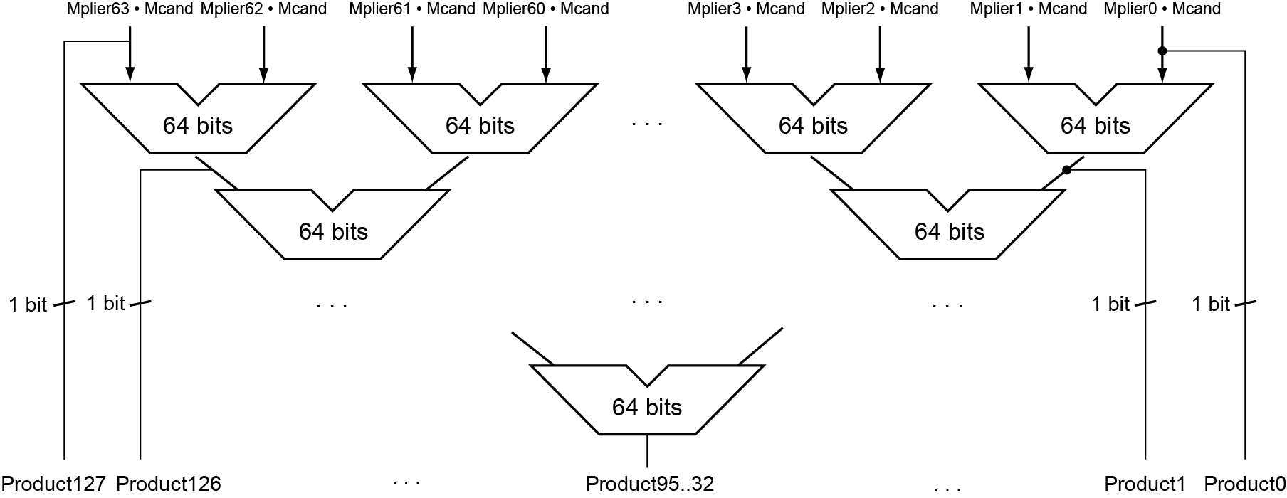
Faster Multiplication
Uses multiple adders
Cost/performance tradeoff
Can be pipelined
Several multiplication performed in parallel

Slide 73
RISC-V Multiplication
Four multiply instructions:
mul: multiply
Gives the lower 64 bits of the product
mulh: multiply high
Gives the upper 64 bits of the product, assuming the operands are signed
mulhu: multiply high unsigned
Gives the upper 64 bits of the product, assuming the operands are unsigned
mulhsu: multiply high signed/unsigned
Gives the upper 64 bits of the product, assuming one operand is signed and the other unsigned
Use mulh result to check for 64-bit overflow

Slide 74
3.5 Division
Check for 0 divisor
Long division approach
If divisor ≤ dividend bits
1 bit in quotient, subtract
Otherwise
0 bit in quotient, bring down next dividend bit
Restoring division
Do the subtract, and if remainder goes < 0, add divisor back
Signed division
Divide using absolute values
Adjust sign of quotient and remainder as required
quotient
dividend
1001
1000 1001010
-1000
10
101
1010
-1000
10
divisor
remainder
n-bit operands yield n-bit quotient and remainder

Slide 75
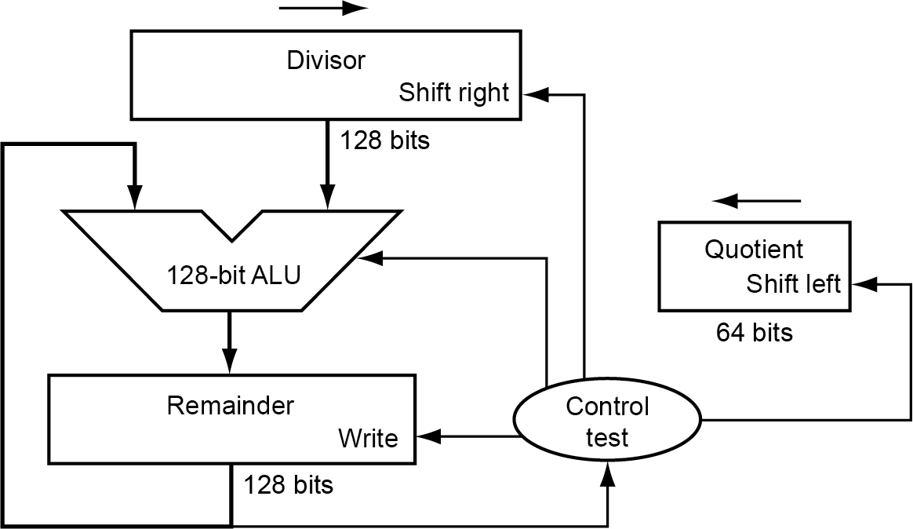
Division V1 --Logic Diagram
At first, the divisor is in the left half of the divisor register, the dividend is in the right half of the remainder register.
Shift right the divisor register each step
Initially divisor in left half
Dividend = quotient × divisor + remainder
Remainder < divisor
Iterative subtraction
Result:
Greater than 0: then we get a 1
Smaller than 0: then we get a 0
Initially dividend

Slide 76
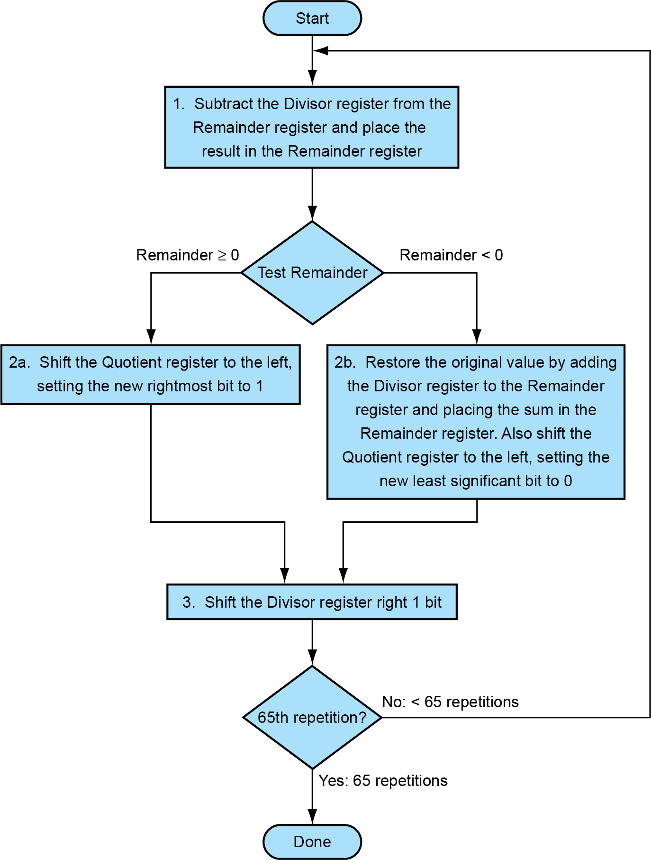
Algorithm V 1
Each step:
Subtract divisor
Depending on Result
Leave or
Restore
Depending on Result
Write '1' or
Write '0'

Slide 77
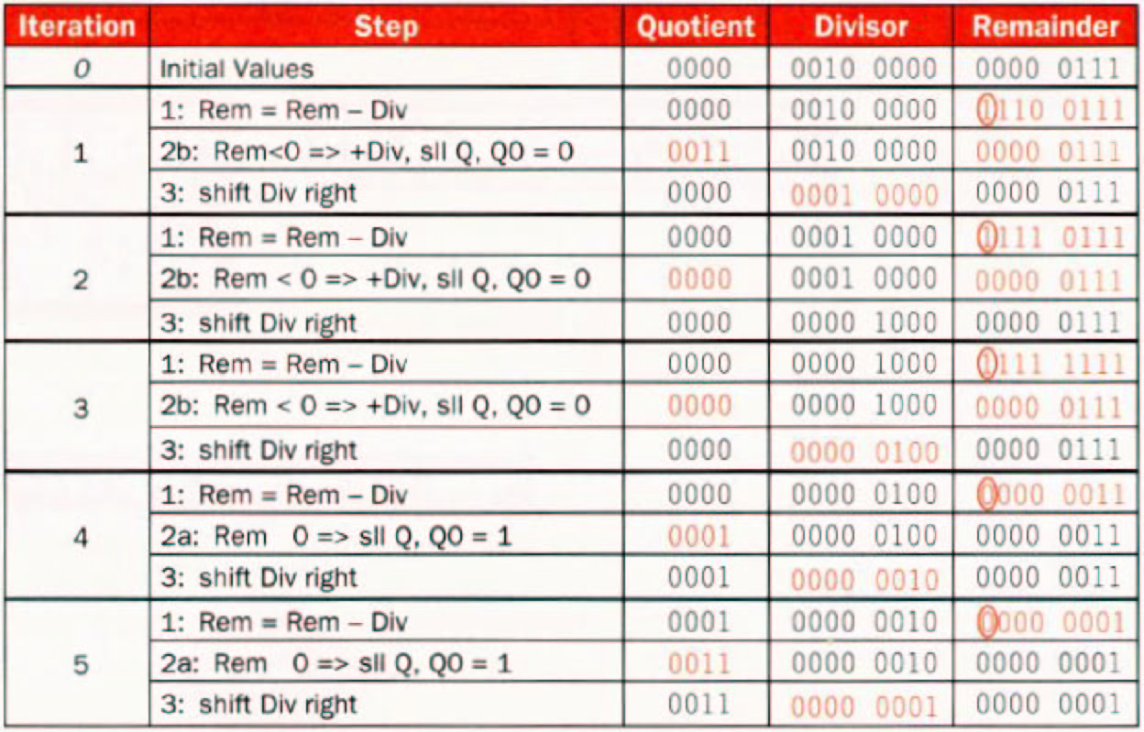
Example (7÷ 2) for division v1 00000111 ÷0010
0000

Slide 78
Two questions
1.Why should the divisor be shifted right one bit each time?
2.Why should the divisor be placed in the left half of the divisor register , and the dividend be placed in the right half of the remainder register at first ?
quotient
divisor
dividend
- divisor
remainder
- divisor
0
remainder
…………

Slide 79
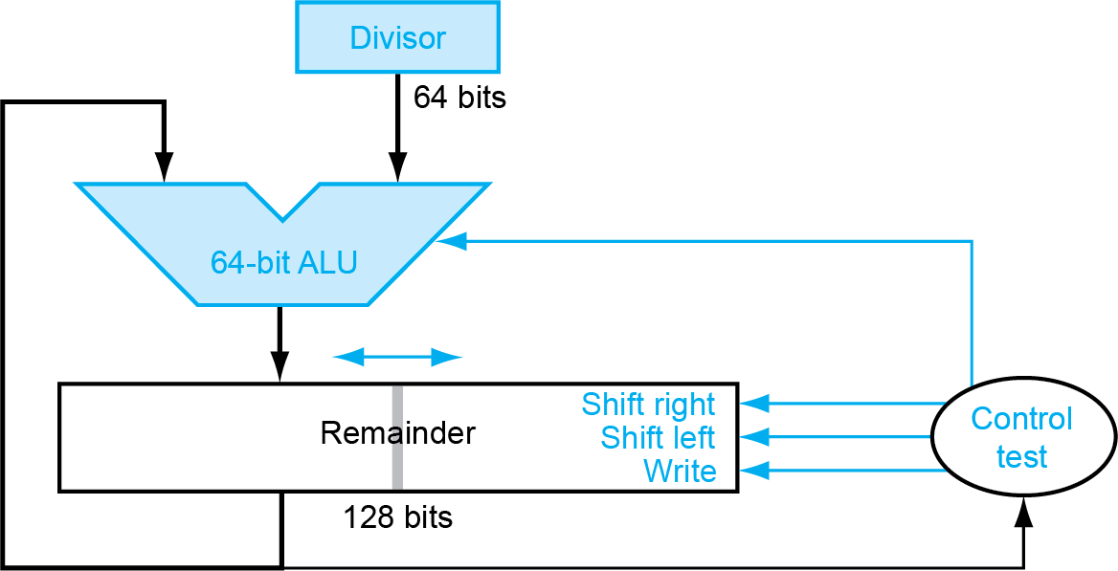
Modified Division
Reduction of Divisor and ALU width by half
Shifting of the remainder
Saving 1 iteration
Remainder register keeps quotient No quotient register required
dividend
One cycle per partial-remainder subtraction
Looks a lot like a multiplier!
Same hardware can be used for both
Notes:
乘法和除法用同样的硬件结构可以实现

Slide 80
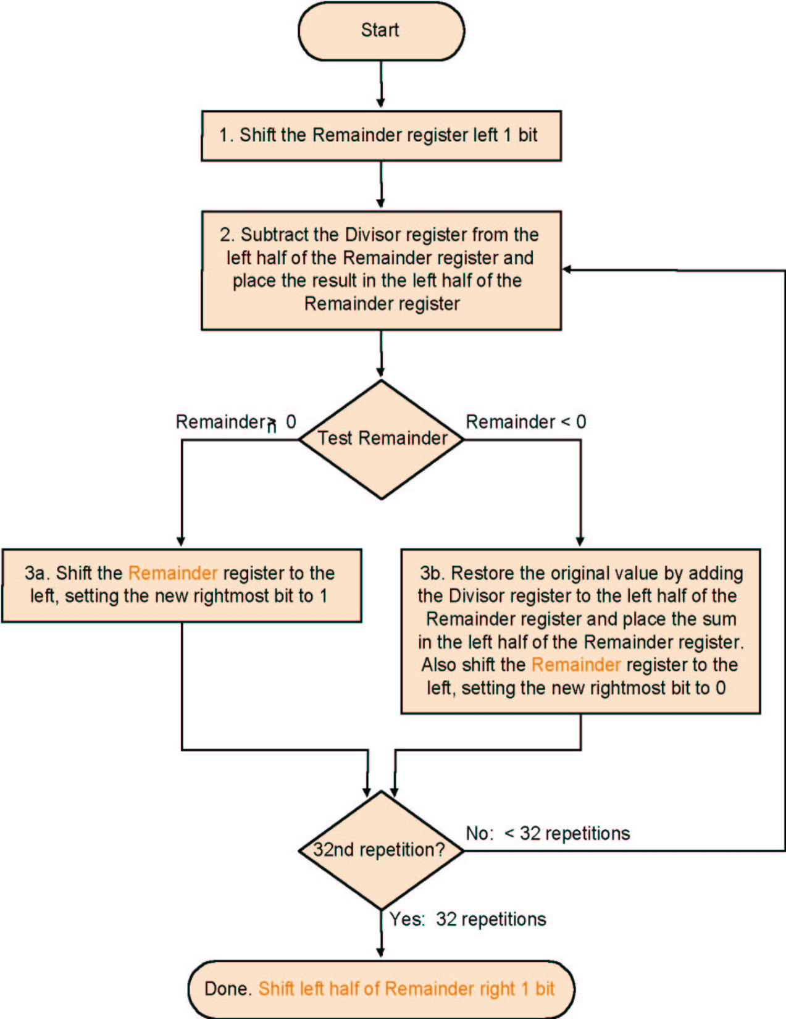
Algorithm V 3
Much the same as
the last one
Except change of
register usage
No: < 64th repetition
64th repetition?
Yes: 64th repetition

Slide 81
Example 7/2 for Modified Division
Well known numbers: 0000 0111/0010
iteration | step | Divisor | Remainder
0 | Initial Values | 0010 | 0000 0111
 | Shift Rem left 1 | 0010 | 0000 1110
1 | 1.Rem=Rem-Div | 0010 | 1110 1110
 | 2b: Rem<0 →+Div,sll R,R₀=0 | 0010 | 0001 1100
2 | 1.Rem=Rem-Div | 0010 | 1111 1100
 | 2b: Rem<0 →+Div,sll R,R₀=0 | 0010 | 0011 1000
3 | 1.Rem=Rem-Div | 0010 | 0001 1000
 | 2a: Rem>0 →sll R,R₀=1 | 0010 | 0011 0001
4 | 1.Rem=Rem-Div | 0010 | 0001 0001
 | 2a: Rem>0 →sll R,R₀=1 | 0010 | 0010 0011
 | Shift left half of Rem right 1 |  | 0001 0011

Slide 82
Signed division
Keep the signs in mind for Dividend and Remainder
(+ 7) ÷( + 2) = + 3 Remainder = +1
7 = 3 × 2 + (+1) = 6 + 1
(- 7 ) ÷(+ 2) = - 3 Remainder = -1
-7 = -3 × 2 + (-1) = - 6 - 1
(+ 7 ) ÷( - 2) = - 3 Remainder = +1
(- 7 ) ÷( - 2) = + 3 Remainder = -1
One 64 bit register : Hi & Lo
Hi: Remainder, Lo: Quotient
Instructions: div, divu
Divide by 0 → overflow : Check by software
Notes:
Mflo, mfhi

Slide 83
Faster Division
Can’t use parallel hardware as in multiplier
Subtraction is conditional on sign of remainder
Faster dividers (e.g. SRT division) generate multiple quotient bits per step
Still require multiple steps

Slide 84
RISC-V Division
Four instructions:
div, rem: signed divide, remainder
divu, remu: unsigned divide, remainder
Overflow and division-by-zero don’t produce errors
Just return defined results
Faster for the common case of no error

Slide 85
3.6 Floating point numbers
Reasoning
Larger number range than integer rage
Fractions
Numbers like e (2.71828) and π(3.14159265....)
Representation
Sign
Fraction
Exponent
More bits for fraction: more accuracy
More bits for exponent: increases the range

Slide 86
Floating Point
Representation for non-integral numbers
Including very small and very large numbers
Like scientific notation
–2.34 × 10⁵⁶
+0.002 × 10^{–4}
+987.02 × 10⁹
In binary
±1.xxxxxxx₂ × 2^{yyyy}
Types float and double in C
normalized
not normalized

Slide 87
Floating Point Standard
Defined by IEEE Std 754-1985
Developed in response to divergence of representations
Portability issues for scientific code
Now almost universally adopted
Two representations
Single precision (32-bit)
Double precision (64-bit)

Slide 88
IEEE Floating-Point Format
single: 8 bits double: 11 bits
single: 23 bits double: 52 bits
S
Exponent
Fraction
S: sign bit (0 ⇒ non-negative, 1 ⇒ negative)
Normalize significand: 1.0 ≤ |significand| < 2.0
Always has a leading pre-binary-point 1 bit, so no need to represent it explicitly (hidden bit)
Significand is Fraction with the “1.” restored
Exponent: excess representation: actual exponent + Bias
Ensures exponent is unsigned
Single: Bias = 127; Double: Bias = 1203

Slide 89
Floating-Point Example
Represent –0.75
–0.75 = (–1)¹ × 1.1₂ × 2^{–1}
S = 1
Fraction = 1000…00₂
Exponent = –1 + Bias
Single: –1 + 127 = 126 = 01111110₂
Double: –1 + 1023 = 1022 = 01111111110₂
31 | 30 …… 23 | 22 …… 0
1 | 0111 1110 | 100 0000 0000 0000 0000 0000
1 bit | 8 bits | 23 bits
Single precision
31 | 30 …… 20 | 19 …… 0
1 | 011 1111 1110 | 1000 0000 0000 0000 0000
1bit | 11 bits | 20 bits
0000 0000 0000 0000 0000 0000 0000 0000
Double precision

Slide 90
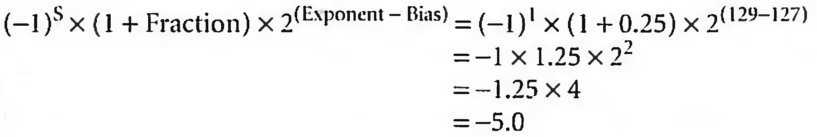
Converting Binary to Decimal Floating Point
31 | 30 …… 23 | 22 …… 0
1 | 1000 0001 | 010 0000 0000 0000 0000 0000
1 bit | 8 bits | 23 bits

Slide 91
Single-Precision Range
Exponents 00000000 and 11111111 reserved
Smallest value
Exponent: 00000001 ⇒ actual exponent = 1 – 127 = –126
Fraction: 000…00 ⇒ significand = 1.0
±1.0 × 2^{–126} ≈ ±1.2 × 10^{–38}
Largest value
exponent: 11111110 ⇒ actual exponent = 254 – 127 = +127
Fraction: 111…11 ⇒ significand ≈ 2.0
±2.0 × 2⁺¹²⁷ ≈ ±3.4 × 10⁺³⁸

Slide 92
Double-Precision Range
Exponents 0000…00 and 1111…11 reserved
Smallest value
Exponent: 00000000001 ⇒ actual exponent = 1 – 1023 = –1022
Fraction: 000…00 ⇒ significand = 1.0
±1.0 × 2^{–1022} ≈ ±2.2 × 10^{–308}
Largest value
Exponent: 11111111110 ⇒ actual exponent = 2046 – 1023 = +1023
Fraction: 111…11 ⇒ significand ≈ 2.0
±2.0 × 2⁺¹⁰²³ ≈ ±1.8 × 10⁺³⁰⁸
Notes:
Exponent: 1~2046

Slide 93
Floating-Point Precision
Relative precision
all fraction bits are significant
Single: approx 2^{–23}
Equivalent to 23 × log₁₀2 ≈ 23 × 0.3 ≈ 6 decimal digits of precision
Double: approx 2^{–52}
Equivalent to 52 × log₁₀2 ≈ 52 × 0.3 ≈ 16 decimal digits of precision

Slide 94
Denormal Numbers
Exponent = 000...0 ⇒ hidden bit is 0
Smaller than normal numbers
allow for gradual underflow, with diminishing precision
Denormal with fraction = 000...0
Two representations of 0.0!

Slide 95
Infinities and NaNs
Exponent = 111...1, Fraction = 000...0
±Infinity
Can be used in subsequent calculations, avoiding need for overflow check
Exponent = 111...1, Fraction ≠ 000...0
Not-a-Number (NaN)
Indicates illegal or undefined result
e.g., 0.0 / 0.0
Can be used in subsequent calculations

Slide 96
Limitations
Overflow:
The number is too big to be represented
Underflow:
The number is too small to be represented

Slide 97
IEEE 754 standard
00... 00_{two} represents 0;
instead of interrupting on a divide by 0, software can set the result to a bit pattern representing +∞ or -∞;
NaN: Not a Number.
±∞ - represented by f=0, E=255, S=0,1 - must obey all mathematical conventions: F+∞=∞, F/∞=0
denormalized numbers - represented by E=0 -values smaller than smallest normalized number - lowering probability of exponent underflow
Single precision |  | Double precision |  | Object represented
Exponent | Fraction | Exponent | Fraction
0 | 0 | 0 | 0 | 0
0 | Nonzero | 0 | Nonzero | denormalized number
1-254 | Anything | 1-2046 | Anything | Floating-point number
255 | 0 | 2047 | 0 | infinity
255 | Nonzero | 2047 | Nonzero | NaN (Not a Number)

Slide 98
Floating point addition
Alignment
The proper digits have to be added
Addition of significands
Normalization of the result
Rounding
Example in decimal
system precision 4 digits
What is 9.999 • 10¹ + 1.610 • 10⁻¹ ?

Slide 99
Example for Decimal
Aligning the two numbers
9.999 •10¹
0.01610 •10¹ → 0.016 •10¹ Truncation
Addition
9.999 • 10¹
+ 0.016 • 10¹
10.015 • 10¹
Normalization
1.0015 • 10²
Rounding
1.002 • 10²
Notes:
Truncation=舍去

Slide 100
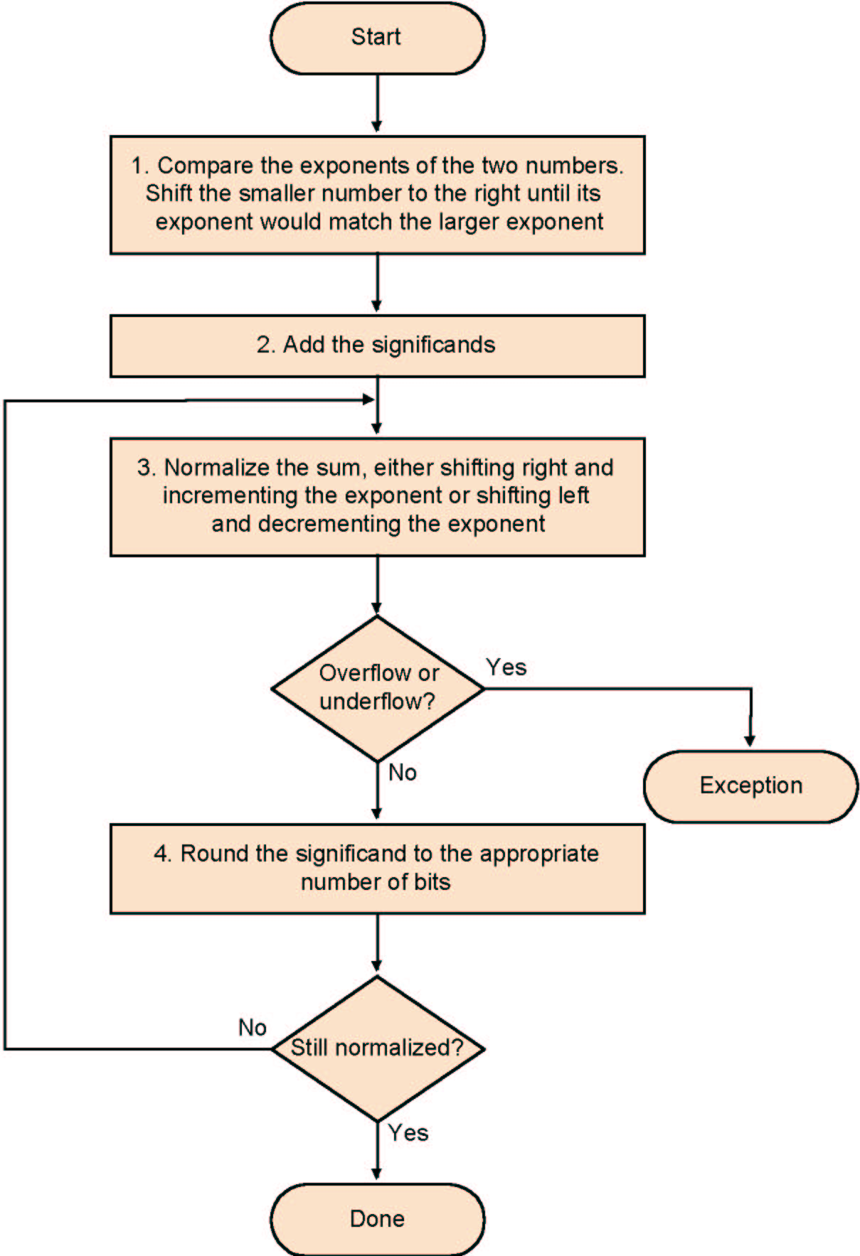
Algorithm
Normalize Significands
Add Significands
Normalize the sum
Over/underflow
Rounding
Normalization

Slide 101
Example y=0.5+(-0.4375) in binary
0.5₁₀ = 1.000₂×2⁻¹
-0.4375₂=-1.110₂×2⁻²
Step1:The fraction with lesser exponent is shifted right until matches
-1.110₂×2⁻² → -0.111₂×2⁻¹
Step2: Add the significands
1.000₂×2⁻¹
+) - 0.111₂×2⁻¹
0.001₂×2⁻¹
Step3: Normalize the sum and checking for overflow or underflow
0.001₂×2⁻¹ → 0.010₂×2⁻² → 0.100₂×2⁻³ → 1.000₂×2⁻⁴
Step4: Round the sum
1.000₂×2⁻⁴ = 0.0625₁₀

Slide 102
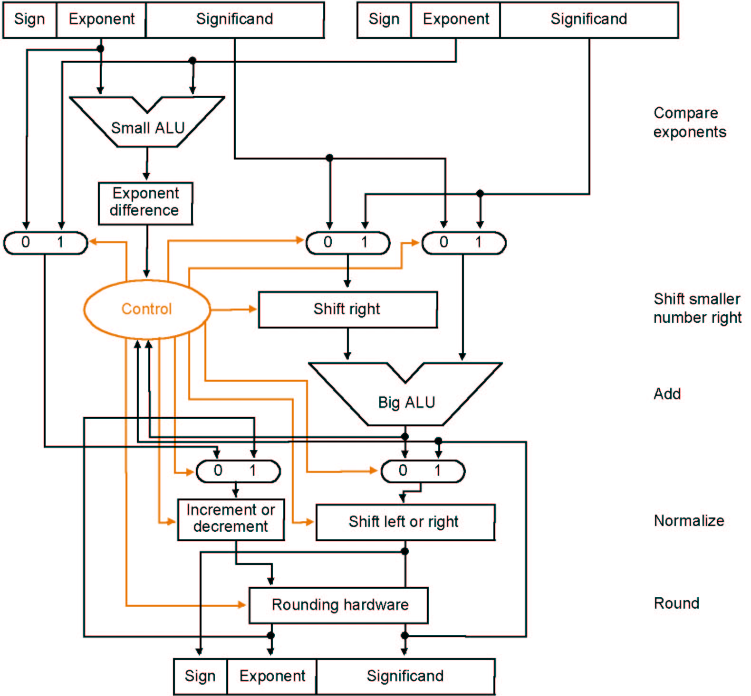
Algorithm

Slide 103
Multiplication
Composition of number from different parts → separate handling
(s1 • 2^{e1}) • (s2 • 2^{e2}) = (s1 • s2) • 2^{e1+ e2}
Example
1 10000010 000 0000 0000 0000 0000 0000 = -1 × 2³
0 10000011 000 0000 0000 0000 0000 0000 = 1 × 2⁴
Both significands are 1 → product = 1 →Sign=1
Add the exponents, bias = 127
10000010
+10000011
110000101
Correction: 110000101-01111111=10000110=134=127+3+4
The result: 1 10000110 000 0000 0000 0000 0000 0000 = -1 × 2⁷

Slide 104
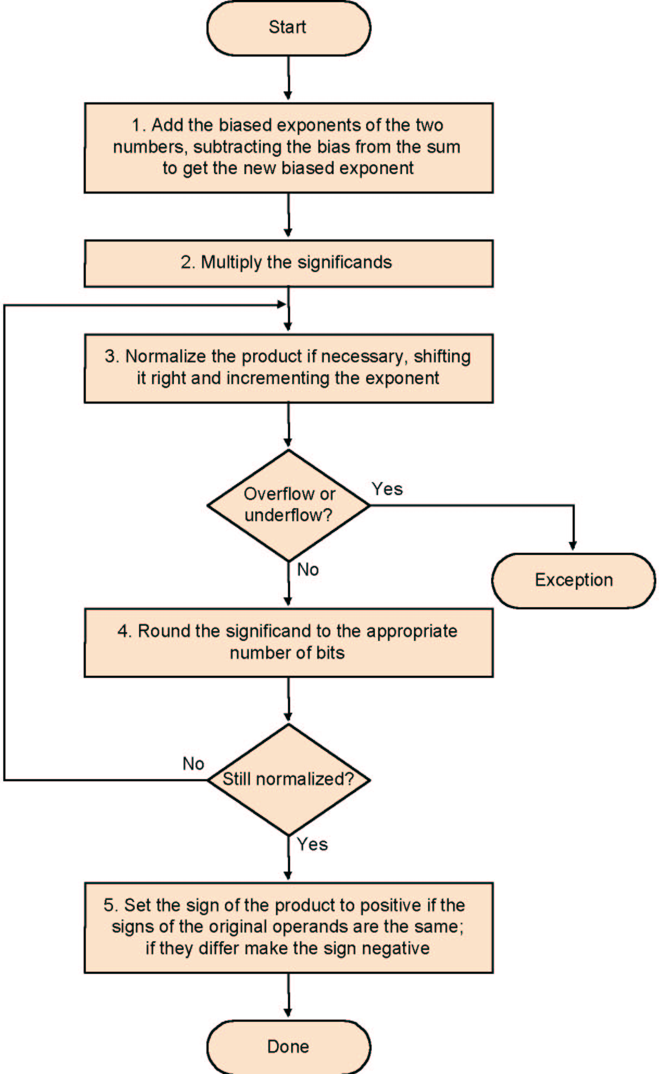
Multiplication
Add exponents
Multiply the significands
Normalize
Over- underflow
Rounding
Sign

Slide 105
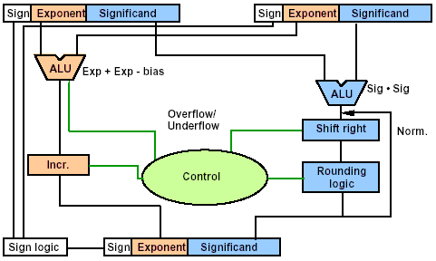
Data Flow

Slide 106
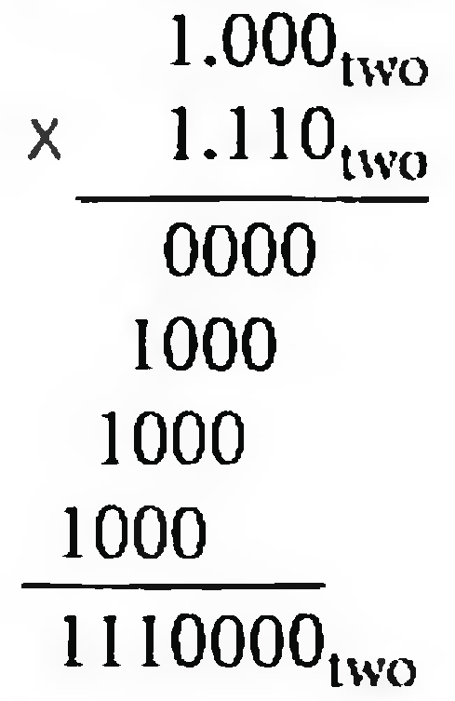
multiplying the numbers 0.5_{ten} and -0.4375_{ten} →1.000_{two}x 2⁻¹ by -1.110_{two}x 2⁻²
Step1:Adding the exponents without bias or using the biased
-1 + (-2)=-3
(-1 + 127) + (-2 + 127) - 127 = (-1 - 2) + (127 + 127-127) =-3+127 = 124
Step 2. Multiplying the significands
1.110000_{two}x2⁻³
Step 3. normalize
127 ≥ -3 ≥ -126, no overflow or underflow.
Step 4. Rounding
1.110_{two}x2⁻³
Step 5. sign
-1.110_{two}x2⁻³ =-0.21875_{ten}

Slide 107
Division-- Brief
Subtraction of exponents
Division of the significands
Normalization
Rounding
Sign

Slide 108
Parallelism and Computer Arithmetic: Associativity
x + (y+ z) = (x + y) + z ?
x = -1.5_{ten} x 10³⁸, y= 1.5_{ten} X 10³⁸, and z = 1.0
x + (y + z) = 0.0
(x+y) + z = 1.0

Slide 109
IEEE 754 standard
Rounding: four rounding modes
Round to 0
Round to +∞
Round to -∞
Round to next even number (default)

Slide 110
Round modes
y | round down (towards −∞) | round up (towards +∞) | round towards zero | round to nearest even
+23.67 | +23 | +24 | +23 | +24
+23.50 | +23 | +24 | +23 | +24
+23.35 | +23 | +24 | +23 | +23
+23.00 | +23 | +23 | +23 | +23
0 | 0 | 0 | 0 | 0
−23.00 | −23 | −23 | −23 | −23
−23.35 | −24 | −23 | −23 | −23
−23.50 | −24 | −23 | −23 | −24
−23.67 | −24 | −23 | −23 | −24

Slide 111
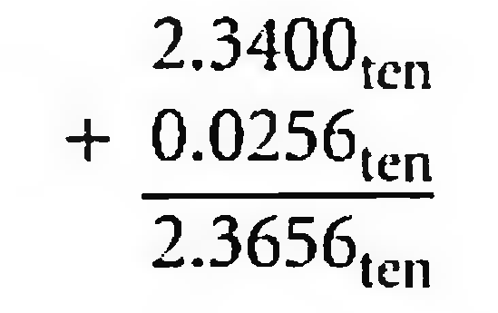
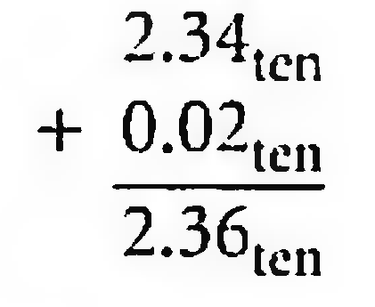
Accurate Arithmetic
IEEE 754 always keeps two extra bits on the right during intermediate additions, called guard and round
Rounding with Guard Digits
Add 2.56_{ten} x 10⁰ to 2.34_{ten} x 10²
The guard digit holds 5 and the round digit holds 6.
Sum=2.37_{ten} x 10².
Rounding without Guard Digits
Sum=2.36_{ten} x 10²

Slide 112
sticky bit
A bit used in rounding in addition to guard and round that is set whenever there are nonzero bits to the right of the round bit.
allows the computer to see the difference between 0.50 ... 00_{ten} and 0.50 ... 0l_{ten} when rounding.
examples in the floating point format with guard, round and sticky bits
Notes:
Guard, rounding, sticky bit

Slide 113
Examples for guard, round, and sticky bit
g r s
1.11000000000000000000100 0 0 0
1.11000000000000000000100 (mantissa used, exact representation)
1.11000000000000000000000 1 1 0
1.11000000000000000000001
1.11000000000000000000000 0 1 0
1.11000000000000000000000
1.11000000000000000000000 1 1 1
1.11000000000000000000001
1.11000000000000000000000 0 0 1
1.11000000000000000000000
1.11000000000000000000000 1 0 0 (the “halfway” case) 1.11000000000000000000000 （LSB=0）
1.11000000000000000000001 1 0 0 (the “halfway” case) 1.11000000000000000000010（LSB=1）

Slide 114
Concluding Remarks
Bits have no inherent meaning
Interpretation depends on the instructions applied
Computer representations of numbers
Finite range and precision
Need to account for this in programs

Slide 115
Concluding Remarks
ISAs support arithmetic
Signed and unsigned integers
Floating-point approximation to reals
Bounded range and precision
Operations can overflow and underflow

Slide 116
END

